Slide 1


ENGLISH LEVEL B1 - II
Lesson 03
TALKING ABOUT THE WEATHER
Notes:
Teacher’s Notes:
Explain the lesson goal: learning words and sentences related to hospitals.
Ask students: Have you ever been to a hospital? Why?

Slide 2

01
Use modal verbs (might, must, can't) to express certainty and possibility about the weather
ENGLISH LEVEL B1 - II

Slide 3

TALKING ABOUT THE WEATHER
WHAT’S THE WEATHER LIKE TODAY?
Look at the picture and answer the questions:
1
What do you see in the picture?
2
What’s the weather like in your city today?
3
How does the weather change during the year?
4
Have you ever experienced extreme weather?

Slide 4

TALKING ABOUT THE WEATHER
Complete the Sentences with Weather Words
Instructions:
Complete the following sentences with the correct weather-related words from the list:
☀️ sunny | 🌧 rainy | 🍃 windy | ☁ cloudy | ❄ snowy
I love going to the beach when the weather is ______.
Be careful driving today! It’s very ______, and the roads are wet.
We can’t see the sun because it’s so ______ outside.
The strong ______ is making the trees move a lot!
We need warm clothes because it’s cold and ______ today.

Slide 5

TALKING ABOUT THE WEATHER FORECAST
TALKING ABOUT THE WEATHER
Activity:
Find out a weather forecast from a newspaper or website.
Instructions:
Read the forecast aloud.
In pairs, discuss:
What will the weather be like tomorrow?
How should we wear for this weather?
What activities can we do in this weather?

Slide 6
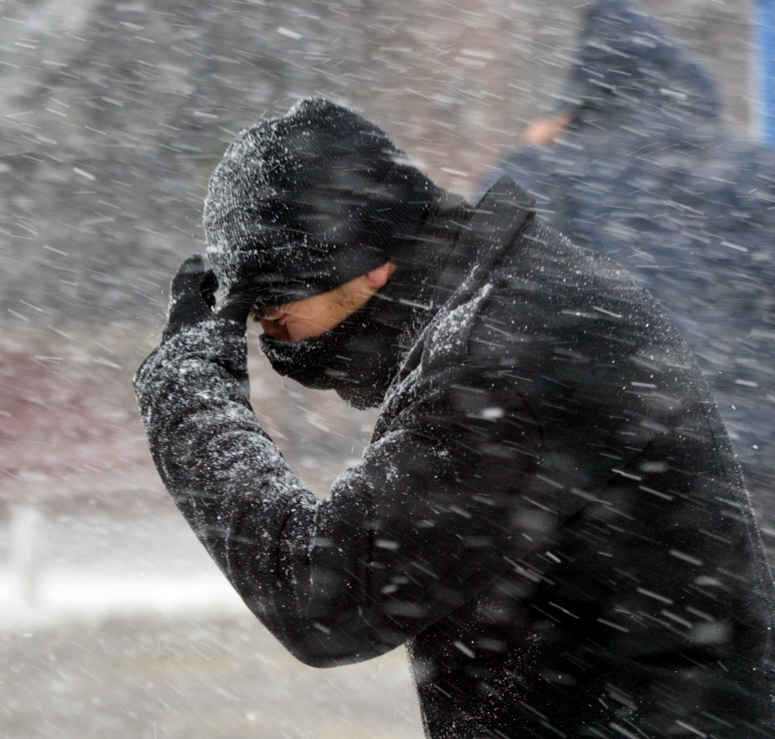

WEATHER CONVERSATIONS
TALKING ABOUT THE WEATHER
Activity: Role-play a conversation about the weather.
Example Dialogue:
A: What’s the weather like today?
B: It’s very windy and cold!
A: Oh no! I forgot my coat. Do you think it will rain?
B: It might rain later. You must take an umbrella.
Pair Task:
Create a similar dialogue using different weather conditions.

Slide 7

TALKING ABOUT THE WEATHER
WEATHER & ACTIVITIES
Activity: Look at the weather descriptions and choose the best activity.
Example:
It’s sunny → (Go to the beach / Stay inside)
It’s rainy → (Go for a picnic / Take an umbrella)
It’s cold and snowy → (Wear shorts / Wear a jacket)

Slide 8
TALKING ABOUT THE WEATHER
ACTIVITIES BASED ON THE WEATHER
Instructions:
Look at the weather descriptions below and match them with an appropriate activity. Write the correct activity next to each weather condition.
Weather Condition | Possible Activities (Choose from the list)
1. Sunny and warm | Build a snowman
2. Cold and snowy | b. Go to the beach
3. Rainy and windy | c. Have a picnic in the park
4. Hot and humid | d. Stay inside and read a book
5. Stormy | e. Fly a kite in the open field
Discuss: What do you like to do when the weather is (hot, cold, rainy, etc.)?

Slide 9

TALKING ABOUT THE WEATHER
USING MODAL VERBS FOR WEATHER PREDICTIONS
Grammar Focus:
Might = Possibility
Will = Strong certainty
Can’t = Strong impossibility
Activity: Complete the sentences:
The sky is dark. It _________ (might/ will /can’t) rain soon.
The sun is shining. It _________ (might/ will /can’t) be cold outside.
There are no clouds. It _________ (might/will /can’t) rain today.

Slide 10

TALKING ABOUT THE WEATHER
USING MODAL VERBS IN WEATHER SENTENCES
Instructions:
Complete the sentences using the correct modal verb (can, could, must, should) based on the context of the weather.
It’s very cold today. You ______ wear a jacket.
The weather is nice, so we ______ go for a walk in the park.
It looks like it will rain later. You ______ take an umbrella.
It’s too foggy outside. Drivers ______ be very careful.
When I was a child, winters were colder, and we ______ see snow every year.

Slide 11
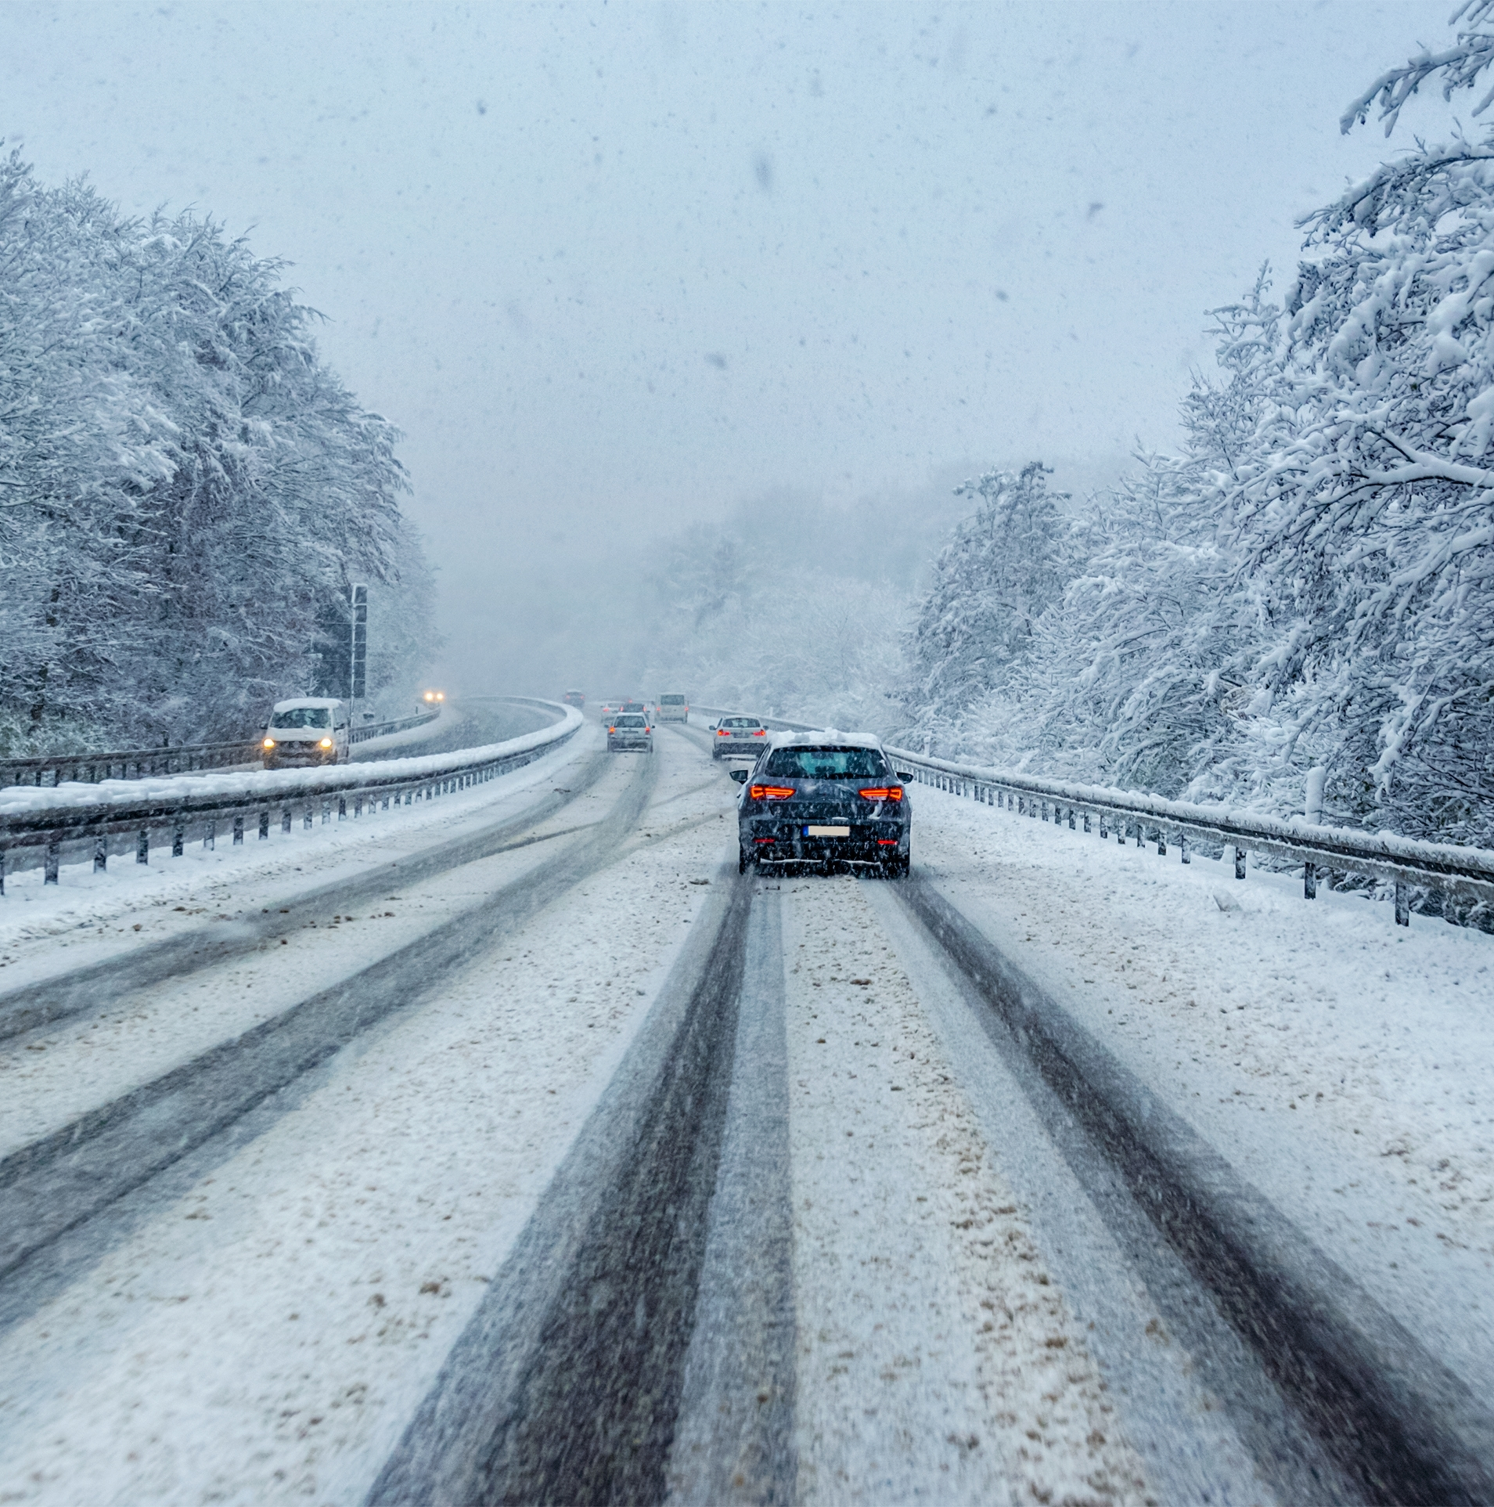
USE PHRASAL VERBS WHEN SPEAKING
LET’S CHECK!
Activity: Quick Quiz
Describe today’s weather using at least two new words and one modal verb.
Share in pairs.
Final Questions:
What was the most interesting thing you learned today?
Can you describe the weather in another country?

